Slide 1
Product Requirements
Product Use Case
Pull Disk Space Info From A User Defined Path
Format The Details Into JSON readable format
MVP Offered : (Product)
Enable OsAgnostics: To capture diskSpaceDetails independent of where product is installed/running
Enable Multiple Format: Provide multiple formats like JSON, XML, Text, etc. to support multiple business operations model
Enable Multiple Publish: Provide multiple publish methods like transfer desired formatted results to local disk, as email attachment, ssh to a shared path server, etc.
MVP Offered : (DevOps)
Enable CI-CD for multiple OS like Windows, Linux, etc.
Enable SCM for version control and CI-CD set-up
MVP Offered : (Infra-Structure)
Enable Windows/Linux OS instances
Enable Jenkins (CI-CD) in Windows/Linux OS
Enable Git (SCM) in Windows/Linux OS
Enable Python (Application Execution Language) in Windows/Linux OS

Slide 2
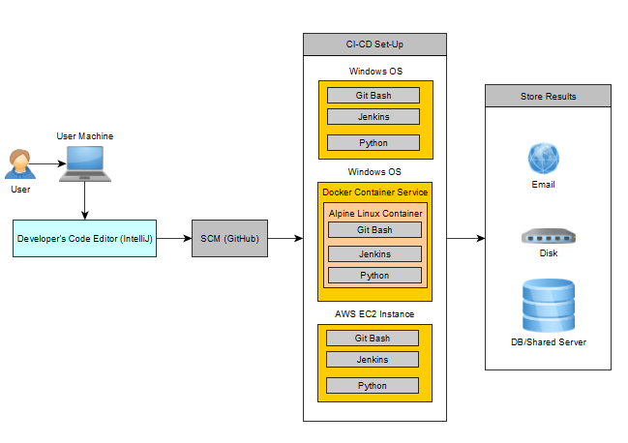
Product High Level Design Flow
User:
Develops Code
Code Editor:
IntelliJ: Used as an IDE for code development.
SCM:
GitHub: To manage code in GitHub
Git Bash: For code check-in and commit in GitHub
CI-CD:
Windows OS:
Git Bash: To check-in code
Python Compiler: To compile and run python code
Jenkins: To define code deployment as pipeline.
Windows OS -> Linux Instance:
Docker Desktop (Container Service): To manage Linux VM in windows OS.
Git Bash: To check-in code
Python Compiler: To compile and run python code
Jenkins: To define code deployment as pipeline.
AWS EC2 Instance:
Git Bash: To check-in code
Python Compiler: To compile and run python code
Jenkins: To define code deployment as pipeline.

Slide 3
Modules/Components Design Flow
Jenkins File
GetStorage.py
ParameterFile.py
String condaInstallPath ="C:\\Users\\manoj\\Anaconda3\\condabin";
String pythonInstallPath = "C:\\Users\\manoj\\AppData\\Local\\Programs\\Python\\Python37-32";
String parameterFileName = "parameter.json";
pipeline {
stage('pipeline initialization') {
steps { }
}
stage('code checkout') {
steps{}
}
stage('prepare environment execute the module') {
steps {
script {
def workspace = env.WORKSPACE
dir(condaInstallPath) {
bat '''dir
conda env list
conda activate base'''
}
dir(workspace) {
bat '‘’SET PATH=%PATH%;%PYTHON_PATH%
type parameter.json > param.json
python GetStorage.py'‘’
}
}
}
}
stage('Move the result file to a different space location') {
steps {
dir(workspace) {
bat '''copy "PublishResults\\diskSpaceInfo.json" /A "C:\\Users\\manoj\\Downloads\\Python Study\\Coding Challenges\\Interview Problem Statement\\System_Programming_getStorageDetails\\CaptureResults\\Windows\\diskSpaceInfo.json" /A /Y'''
}
}
}
}
}
Class GetStorage:`
def __init__(self, path, osProxy, scriptName, fileFormat, publishType)
def initializeClassObjects(self)
def initializeGlobalVariables(self)
def validateParameters(self)
def getStorageDetails(self)
def runScript(self)
def loadStorage(self)
def formatFile(self)
def resultsPublisher(self)
parameterFile = "param.json"
parameterFile = ParameterFile(parameterFile) #Initialize ParameterFile Class
osProxy, scriptName, fileFormat, publishType, path = parameterFile.readParameterFile()
newPath = r'C:\{}'.format(path)
#Initialize GetStorage Class
getStorage = GetStorage(newPath, osProxy, scriptName, fileFormat, publishType)
getStorage.validateParameters() #Validate All Parameters
getStorage.getStorageDetails() #Get Storage Details
getStorage.runScript() #Script To Captures Disk Space -> A Raw File
getStorage.loadStorage() #Transfer Raw File -> To A Common Format
getStorage.formatFile() #Detect Output File Formatter
getStorage.resultsPublisher() #Load Details Into Desired Format
Class ParameterFile:`
def __init__(self, *param)
def readParamterFile(self, *param)
Jenkins Parameters
Validator.py
Class Validator:`
def validatorNull(self, *param)
def validateEmpty(self, *param)
def validateGetValue(self, *param)
FileFormatter.py
Class Validator:`
def __init__(self):
def loadJsonFileFormat(self, commonFrameworkResults)
def loadXMLFileFormat(self, commonFrameworkResults)
def loadTextFileFormat(self, commonFrameworkResults)
Prepare Execution Environment
PublishResults.py
Class Validator:`
def __init__(self)
def transferFileToDisk(self, resultsFileName, commonFrameworkResults)
def transferFileToEmail(self, resultsFileName, commonFrameworkResults)
def transferFileToSharedServer(self, resultsFileName, commonFrameworkResults)
Trigger Python Module
ExtractDetails.py
Class Validator:`
def __init__(self):
def transferFileToDisk(self, resultsFileName, commonFrameworkResults)
def transferFileToEmail(self, resultsFileName, commonFrameworkResults)
def transferFileToSharedServer(self, resultsFileName, commonFrameworkResults)
Pull Results From Workspace To Local Storage

Slide 4
Windows Pipeline Flow
GetStorage.py
ParameterFile.py
Validator.py
FileFormatter.py
PublishResults.py
ExtractDetails.py
{
"osProxy" : "Windows",
"scriptName" : "folderPathFileSizeInfo.bat",
"fileFormat" : "json",
"publishType" : "disk",
"path" : "Users\\manoj\\Downloads\\Python Study\\Coding Challenges\\Interview Problem Statement\\System_Programming_getStorageDetails"
}
Read Parameter File To Proceed With
Perform Validation
Run Windows Batch Script And Format With .json File Type
Load The Results Into Local Disk
Transfer File To Disk

